Slide 1
WEB DEV 101
Vol. 1
By,
Vishnu Bhagirathan
Aadil Sajid

Slide 2


About Us
VISHNU BHAGIRATHAN
AADIL SAJID
Freelance Web Developer
Former GLUG Website maintainer, Mozilla Campus Club Lead, GLUG Technical Lead.
Freelance UI/UX, graphics designer and Web Developer,
Former GLUG Technical lead,
Visual Media creator

Slide 3
What You’ll Need
CODE EDITOR
BROWSER
GITHUB CLIENT
01
02
03
VS Code Plugins
04
VS Code or
VS COdium
Google Chrome
Mozilla Developer
GitHub Desktop
Git CLI
Prettier
LiveServer

Slide 4


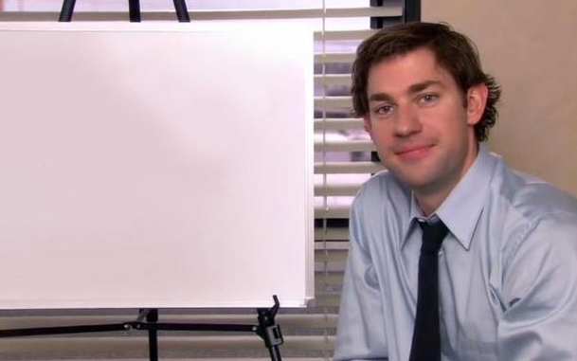
WHAT YOU’LL LEARN
The languages & tools of web development
Key concepts (eg URL, HTTP, DOM, etc)
How websites work
Inspect network traffic using DevTools
Basics of HTML and CSS
Validating web pages
Living in Spain without the S

Slide 5
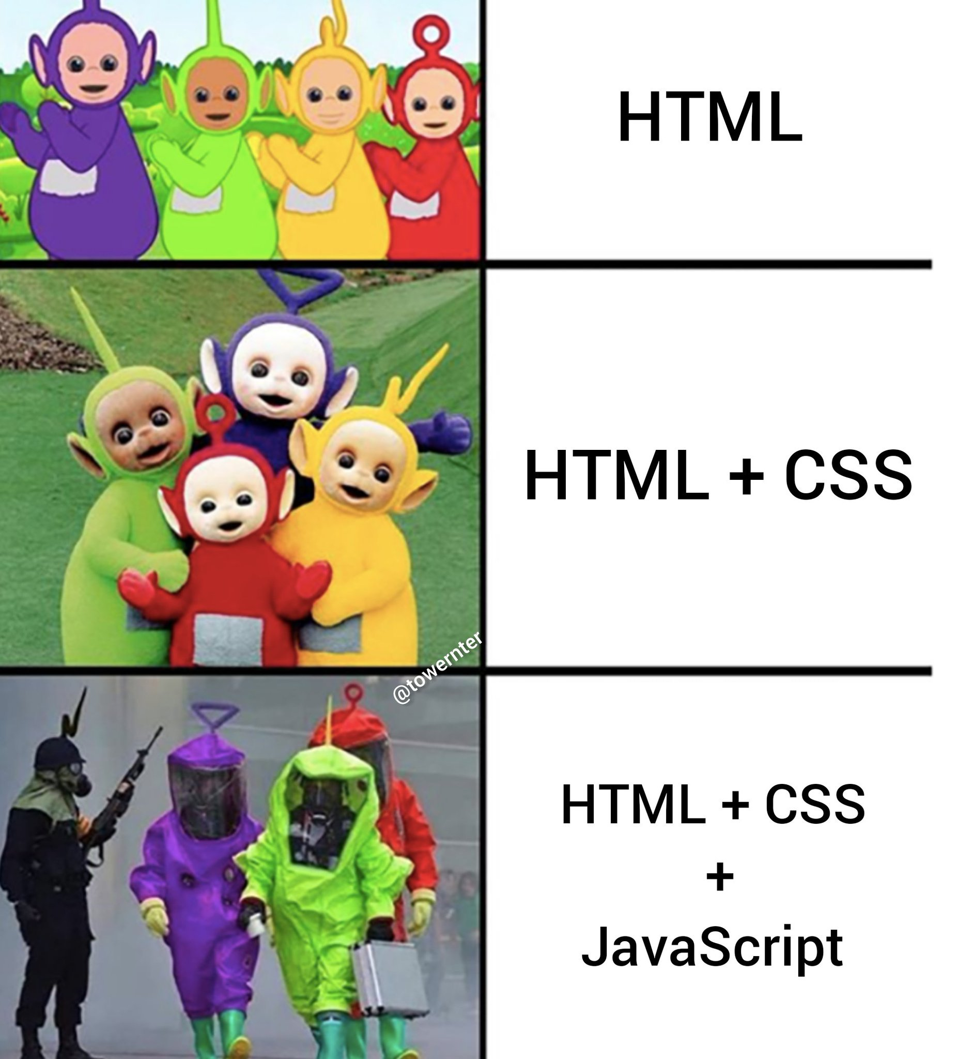
01
Front End
HTML, CSS, JS

Slide 6
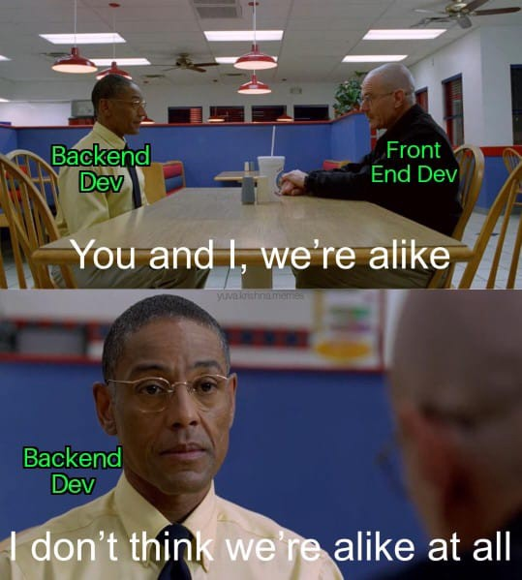
02
Back End
SQL, Python, MS Azure

Slide 7
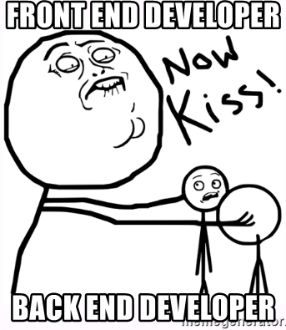
03
Full Stack
HTML, CSS, JS, SQL,
MS Azure, Python

Slide 8




LEARNING TIMELINE
HTML
JS
CSS
GIT
2 weeks
3 weeks
WEEK 2
WEEK 8
WEEK 5
WEEK 9
3 weeks
1 week

Slide 9
NOTE-WORTHY TERMS
URL
SERVER
RESPONSIVE
DOM
CLIENT
DEPLOYMENT
Uniform Resourse Location
Computer/s that host our target/website
Ensuring correct display of website on any device
Document Object Model
User or browser
Hosting a website on the Internet

Slide 10

How it works?
GET request
Server
Client-Server Model
Client request a service
Server provides the service
Protocols
HTTP
HTTPS
Request
GET /index.html HTTP/1.1
HOST: www.wish-new.me
Accept-Language: en-us
Response
HTTP/1.1 200 OK
Date: 3 Mar 2022 09:15
Content-Type: text/html
<!DOCTYPE html>
<html>
…..
</html>
POST response
Client

Slide 11

INSPECTING HTTP REQUESTS & RESPONSES

Slide 12
INTRODUCTION TO < HTML >

Slide 13
What you’ll learn
LINKS
IMAGES
CONTAINER ELEMENTS
TEXT
STRUCTURAL ELEMENTS
LISTS AND TABLES

Slide 14
INTROUCTION TO { CSS }

Slide 15
CASCADING STYLE SHEETS
Cascading Style Sheets (CSS) is a style sheet language used for describing the presentation of a document written in a markup language like HTML. CSS is a cornerstone technology of the World Wide Web, alongside HTML and JavaScript.
Not a programming language
Stylesheet/Styling language
Used for website layout and design

Slide 16
METHODS OF ADDING CSS
There are three methods for styling:
Inline CSS
Internal CSS
External CSS

Slide 17
CSS SELECTORS
a { background-color : yellow ; }
1 2 3 4 5 6 7
Value
Declaration Separator
Declaration End
Selector
Declaration start
Property
Separator

Slide 18
COLOURS IN CSS
body
{
color: red;
background-color: coral;
}
h1
{
color: #00ff00;
}
p
{
color: rgb(0,0,255);
}
Colour names
HTML5 colour names
Hexa decimal
RGB

Slide 19
FONTS
Google fonts
Web Safe fonts
Importing
Links
https://www.w3schools.com/cssref/css_websafe_fonts.asp
https://fonts.google.com/

Slide 20
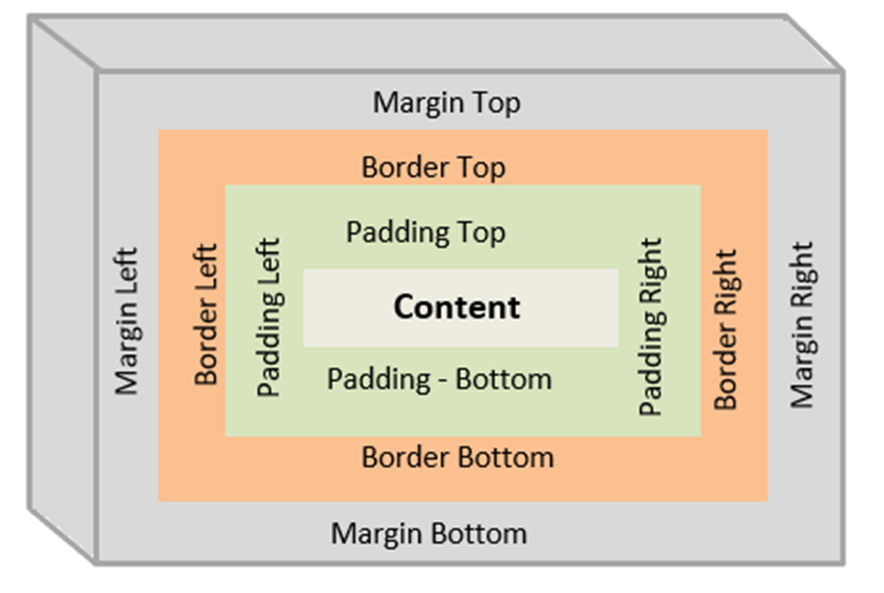
BOX MODEL

Slide 21
MARGIN AND PADDING
MARGIN
PADDING
https://www.w3schools.com/css/css_margin.asp
https://www.w3schools.com/css/css_padding.asp

Slide 22
GITHUB
A version control platform

Slide 23

THANKS!
DO YOU HAVE ANY QUESTIONS?
VISHNU
AADIL
BHAGIRATHAN
SAJID
vishnub341@gmail.com
+91 88487 52606
wish-new.me
aadil.sajid23@gmail.com
+91 70127 93338
Linkedin.com/wishnew8
@wish_new8
Linkedin.com/aad33l
@aad33l

